Slide 1
CSc 330 Take Home Test
Group B - Tyler, Dan, Max, Brent, Jaimee, Brad, Shaquile, and Nick

Slide 2


Type Inference in Python: Introduction
Type inferencing: a task completed by the compiler of a language. The compiler attempts to identify which types are most accurate for a program that does not specify the types of its variables. Type checking occurs at run time, rather than compile time. There is no way to infer the types before the code executes Atomic type inference is possible, but abstract types are unknown to the language and cannot be type-checked

Slide 3
Type Inference in Python: Application
Frequently used type inference algorithms, such as Hindley-Milner and the Cartesian product, cannot be applied to Python. Two approaches to type inference in Python are Starkiller and Psyco.Starkiller:
created by Michael Salib
converts code into C++
uses the Cartesian Product algorithm to determine types
Starkiller is not compatible with dynamic code or dynamic modulesPsyco:
created by Armin Rigo, further developed/maintained by Christian Tismer
written in C
generates x86
no longer maintained, “dead”

Slide 4
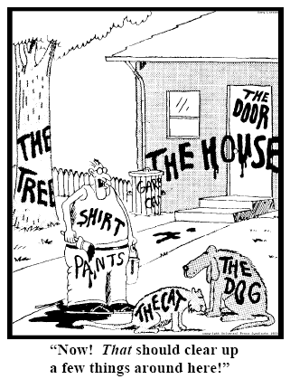
Type Inference in Python: Benefits
code can be produced more efficiently
function calls gain flexibility argument types are not restricted
less code required, smaller programs
compilers can catch ‘type mismatch’ problems before they cause errors during run-time.

Slide 5

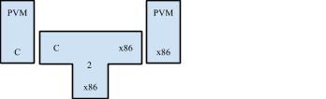
Implementation/Toolsets used by Python
The standard Python implementation, CPython, uses a C compiler to translate Python code into Python Byte Code. This byte code is interpretted by a Python Virtual Machine, also written in C.
A Python Virtual Machine, written in C, can be translated into an executable by using a C compiler. While shown here, if your system has a C compiler written for it, the PVM can be compiled for it. That is, it’s not limited to running on x86 machines.
Notes:
Original Python compiler in C → CPython
^This was because of the availability and standardisation of C

Slide 6
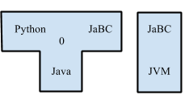
Other Implementations of Python
PyPy: is a translation framework and an interpreter written in RPython (a subset of the Python language). It runs on top of CPython, but provides further optimization by introducing GC and a JIT compiler.
Jython: compiles Python programs into Java Byte Code, which can be executed on a JVM.
Notes:
Jython: Python to Java Byte Code compiler - uses Java classes instead of Python libraries

Slide 7
More Implementations
IronPython, written in C#, translates Python into Microsoft CLR for use on Microsoft’s .NET framework
Shed Skin, still experimental, translates Python into C++ and is written in a combination of the two languages
Pyjamas allows developers to write web applications in Python, then translate them into Javascript
Notes:
Shed Skin’s subset of Python is very restrictive
Python is much easier to read than Javascript/HTML, Pyjamas comes with the API to allow for Python->Javascript

Slide 8
BNF Grammar of Python
Latest BNF (Backus-Naur-Form) Grammar released for Python is for Python 3.3.2.
Python 3.4.0 was released on September 9th, 2013 but is not suitable for production environments, therefore, we have written the railroad diagram of the BNF Grammar for Python 3.3.2.
In the next few slides, we will present some of the syntax diagrams for the while, for, and try loops in Python

Slide 9
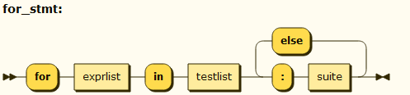
Python’s for loop in Syntax Diagram
for_stmt: 'for' exprlist 'in' testlist ':' suite ['else' ':' suite]

Slide 10
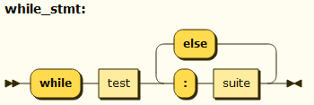
Python’s While Loop
while_stmt: 'while' test ':' suite ['else' ':' suite]

Slide 11
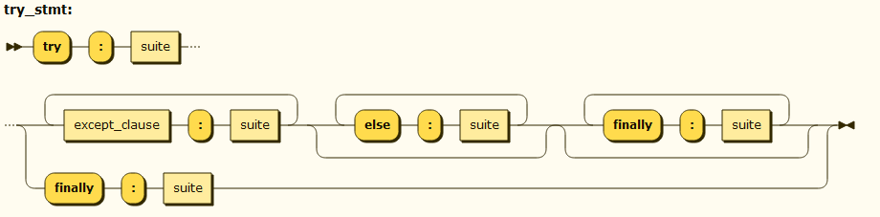
Python’s Try Loop
try_stmt: ('try' ':' suite ((except_clause ':' suite)+ ['else' ':' suite] ['finally' ':' suite] | 'finally' ':' suite))

Slide 12
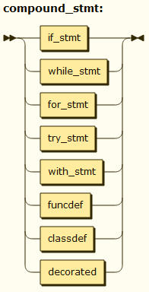
Compound Statements
Compound statements contain groups of other statements and control the execution of those other statements.
compound_stmt: if_stmt | while_stmt | for_stmt | try_stmt | with_stmt | funcdef | classdef | decorated

Slide 13
Compound Statements
The if, while and for statements implement traditional control flow constructs.
‘Try’ specifies exception handlers and/or cleanup code for a group of statements.
Notice that function and class definitions are also syntactically compound statements

Slide 14
History of Python
Created in the early 1990s by Guido Van Rossum
A successor to the language ABC
Notes:
Influenced by many other popular languages of the time as well not just ABC.

Slide 15
Influences From ABC
One of the greatest influences on Python
provided use of indentation, concept of high-level data types
inspiration for and interpreted language with a simple elegant syntax.
Python expanded ABC’s objected oriented nature.

Slide 16
Influence From C
Type implementation borrowed from C includes: definitions of literals, identifiers and operators and its expression syntax.
Break and return statements work the same in Python as in C.
the use of 0 as the base for indexing operations.
the use of 0 and non-0 for false and true.

Slide 17
Differences From C
Much simpler syntax!
No curly braces or semicolons.
No need to declare variables.
No need to explicitly state types.
Pointer type is eliminated.

Slide 18
Similarities To Perl
Both are scripting languages.
Inclusion of powerful string, list, and dictionary data types.
Access to high and low level I/O and other system calls.
Both suitable for small scripts or one-time programming tasks as well as other sources.

Slide 19
Differences From Perl
Perl has support for regular expression matching and formatted output built right into the core of the language.
Python has more general structures for lists and dictionaries.
In Perl you must explicitly indicate types for variables with a special character.
Notes:
Lists and dictionaries in Python can take any types as elements; however, in Perl only strings and integers are acceptable as elements.

Slide 20
Other Influences
Modula-3 provided modules and exceptions
Icon gave the slicing operations
Constructor and destructor functions were inspired by C++.

